Slide 2
Why I think I should be a Wellbeing Ambassador I am
Always positive
Resilient
Helpful
Kind and Caring

Slide 3
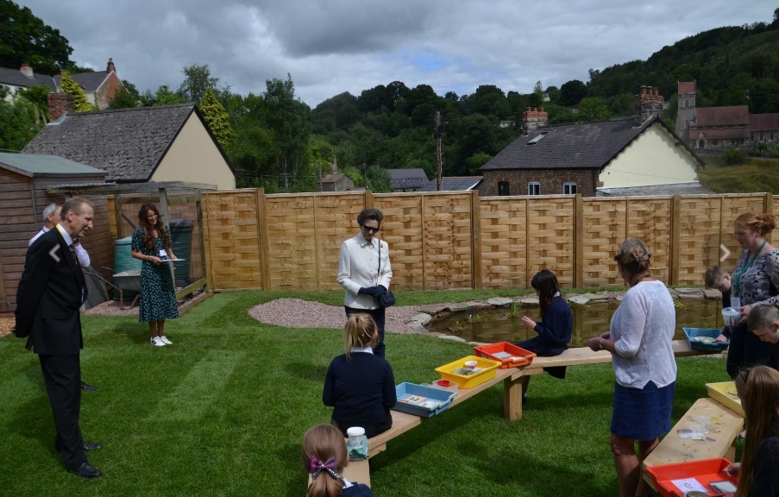
The Wellbeing Garden is a happy place where we can talk and share our feelings and emotions. We could make some bird feeders to encourage the birds to visit the garden

Slide 4
We all should be happy sometimes but other days we could feel sad and down
If you needed to talk I would be there to listen
I would listen to your opinions and what you think
I work well with others in a team

Slide 5
I thought we could have a how you’re feeling board
We could have a box in each classroom with cards with emotions on and we put our emotions for the day on the board so we know how people feel
Sad
Happy
Anxious

Slide 6
I can organise Events such as
ANTI BULLIING WEEK & CHILDREN IN NEED

Slide 7
Thank you for listening

